Slide 1

Automotive Technology:
A Systems Approach, 8e
Chapter 7: Working Safely in the Shop
Rob Thompson and Jack Erjavec, Automotive Technology: A Systems Approach, 8th Edition. © 2025 Cengage. All Rights Reserved. May not be scanned, copied or duplicated, or posted to a publicly accessible website, in whole or in part.

Slide 2
Chapter Objectives (1 of 2)
07.01 Explain the basic principles of personal safety, including protective eyewear, clothing, gloves, shoes, and hearing protection.
07.02 Explain the procedures and precautions for safely using tools and equipment.
07.03 Explain the precautions that need to be followed to safely raise a vehicle on a lift.
07.04 Understand the importance of safety and accident prevention in an automotive shop.

Slide 3
Chapter Objectives (2 of 2)
07.05 Explain manufacturer and government warnings and regulations.
07.06 Identify the purpose and scope of OSHA’s responsibilities.
07.07 Explain what should be done to maintain a safe working area in a shop.
07.08 Describe the purpose of the laws concerning hazardous wastes and materials, including the Right-To-Know laws.
07.09 Describe your rights, as an employee and/or student, to have a safe place to work.

Slide 4
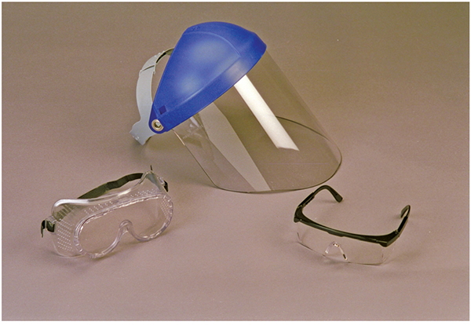
Personal Safety (1 of 3)
07.01 Explain the basic principles of personal safety, including protective eyewear, clothing, gloves, shoes, and hearing protection.
Eye Protection
  To be safe, wear suitable eye protection whenever you are working in the shop.
  In most shops, this is not an option—you must wear eye protection.
  There are many types of eye protection available.

Slide 5
Personal Safety (2 of 3)
Clothing that hangs out freely, such as shirttails, can create a safety hazard and cause serious injury.
Long hair and loose, hanging jewelry can create the same type of hazard as loose-fitting clothing.
Boots or shoes made of leather, or a material that approaches the strength of leather, offer good protection from falling objects.
Never smoke while working on a vehicle or while working in the shop.
Playing around or “horseplay” is not fun when it sends someone to the hospital.
To prevent serious burns, keep your skin away from hot metal parts.
Keep your work area clean and uncluttered. Make sure you clean up all spills before continuing to work.

Slide 6
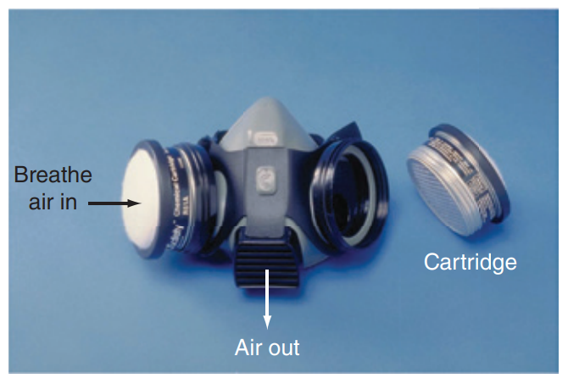
Personal Safety (3 of 3)
Technicians often work with chemicals that have toxic fumes.
Air or respiratory masks should be worn whenever you are exposed to toxic fumes.
Cleaning parts with solvents and painting are examples of when respiratory masks should be worn.

Slide 7
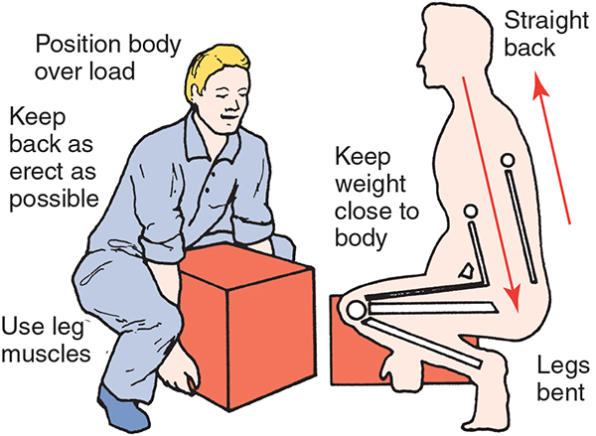
Lifting and Carrying (1 of 3)
Follow these steps:
  Place your feet close to the object. Position your feet so you will be able to maintain a good balance.
  Keep your back and elbows as straight as possible. Bend your knees until your hands reach the best place to get a strong grip on the object.
  If the part is in a cardboard box, make sure the box is in good condition. Old, damp, or poorly sealed boxes will tear and the part will fall out.

Slide 8
Lifting and Carrying (2 of 3)
Follow these steps continued:
  Firmly grasp the object or container. Never try to change your grip as you move the load.
  Keep the object close to your body, and lift it up by straightening your legs. Use your leg muscles, not your back muscles.
  If you must change your direction of travel, never twist your body. Turn your whole body, including your feet.
  When placing the object on a shelf or counter, do not bend forward. Place the edge of the load on the shelf and slide it forward. Be careful not to pinch your fingers.

Slide 9
Lifting and Carrying (3 of 3)
Follow these steps continued:
  When setting down a load, bend your knees and keep your back straight. Never bend forward. This strains the back muscles.
  When lowering something heavy to the floor, set the object on blocks of wood to protect your fingers. You should also use back-protection devices when you lift heavy objects. Always lift and work within your ability and ask others (or use a hoist) to help when you are not sure whether you can handle the size or weight of an object. Even small, compact parts can be surprisingly heavy or unbalanced. Think about how you are going to lift something before beginning.

Slide 10
Professional Behavior
Accidents can be prevented simply by the way you behave.
The following list does not include everything you should or should not do; it merely gives some things to think about:
  Never smoke while working on a vehicle or while working in the shop.
  Playing around or “horseplay” is not fun when it sends someone to the hospital.
  To prevent serious burns, keep your skin away from hot metal parts.
  Keep your work area clean and uncluttered. Make sure you clean up all spills before continuing to work.

Slide 11
Tool Safety and Equipment (1 of 12)
07.02 Explain the procedures and precautions for safely using tools and equipment.
Hand Tool Safety
Here are some of the following tips when using hand tools:
  Keep all tools grease-free.
  Inspect your tools for cracks, broken parts, or other dangerous conditions before you use them. Never use broken or damaged tools.
  Hand tools should only be used for the purpose they were designed for. Use the right tool for the job.
  Make sure the tool is of professional quality.
  Always use the correct size of wrench.

Slide 12
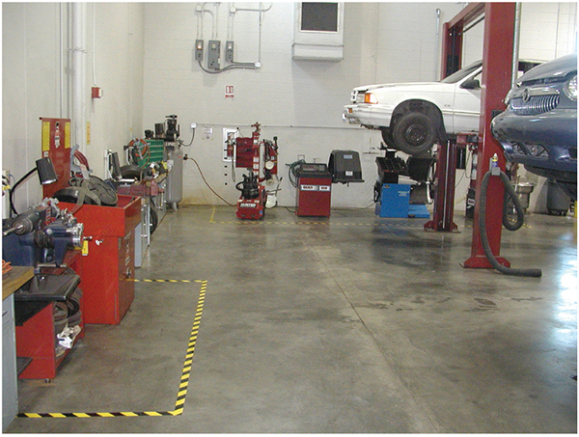
Tool Safety and Equipment (2 of 12)
Power Tool Safety
Working within or even near these areas often requires additional PPE over and above standard safety glasses, uniforms, and boots. For example, when using a bench grinder, a full face shield should be used to prevent debris from flying into your face.
Be sure to identify what forms of PPE are necessary when working in and around these areas. Power tools are operated by an outside power source, such as electricity, compressed air, or hydraulic pressure.

Slide 13
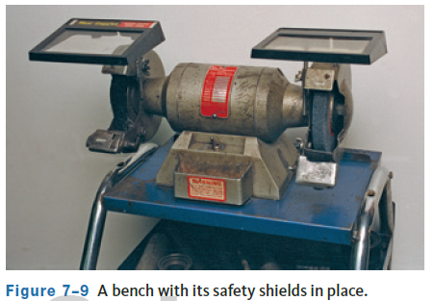
Tool Safety and Equipment (3 of 12)
Electrical Tools
When using an electrically powered tool, make sure it is properly grounded. Check power cords for insulation cracks, as well as bare wires, before using it.
When using a bench or floor grinding wheel, check the machine and the grinding wheels for signs of damage before using them. If the wheels are damaged, they should be replaced before using the machine. Be sure to place all safety guards in position.

Slide 14
Tool Safety and Equipment (4 of 12)
Compressed Air Tools
Tools that use compressed air are called pneumatic tools. Compressed air is used to inflate tires, apply paint, and drive tools, such as air ratchets and impact wrenches.
Before using a pneumatic tool, check all hose connections for leaks and the air line for damage.
When using an air nozzle, wear safety glasses and/or a face shield. Particles of dirt and pieces of metal, blown by the high-pressure air, can penetrate your skin or get into your eyes.
Never use compressed air to blow dirt from your clothes or hair or use compressed air to clean the floor or workbench.

Slide 15
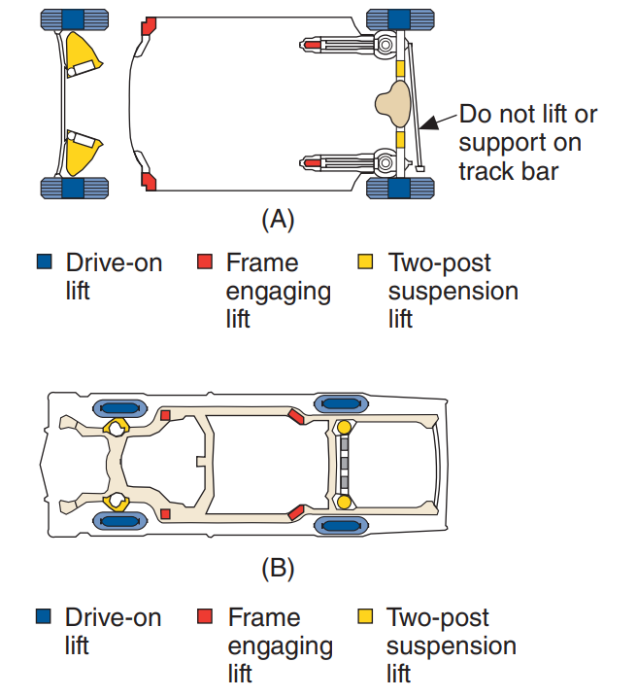
Tool Safety and Equipment (5 of 12)
Lift Safety
  Always be careful when raising a vehicle on a lift or a hoist.
  Adapters and hoist plates must be positioned correctly on lifts.
  There are specific lift points.
  These points allow the weight of the vehicle to be evenly supported by the adapters or hoist plates.

Slide 16
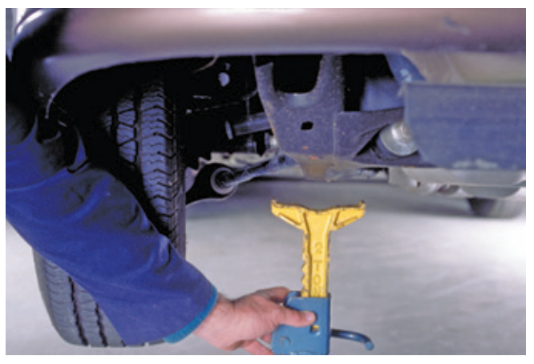
Tool Safety and Equipment (6 of 12)
Jack and Jack Stand Safety
A vehicle can be raised by a hydraulic jack.
Always the manufacturer’s recommended lift points.
Safety stands, also called jack stand, are supports of various heights that sit on the floor and must be used.
Like jacks, jack stands also have a capacity rating. Always use a jack stand of the correct rating.

Slide 17
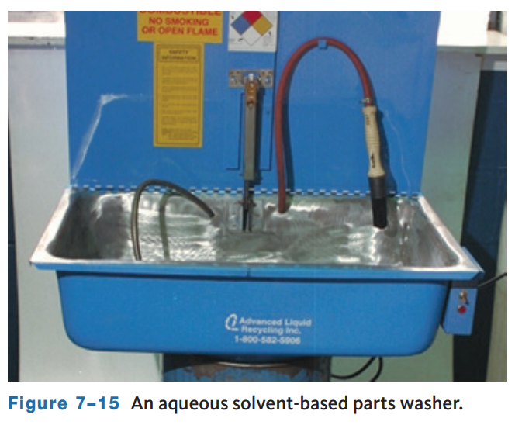
Tool Safety and Equipment (7 of 12)
Cleaning Equipment Safety
  Cleaning automotive parts can be divided into three basic categories.
    Chemical cleaning relies on chemical action to remove dirt, grease, scale, paint, or rust.
    Thermal cleaning relies on heat, which bakes off or oxidizes the dirt.
    Abrasive cleaning relies on physical abrasion to clean the surface.

Slide 18
Tool Safety and Equipment (8 of 12)
Vehicle Operation
When a customer brings a vehicle in for service, it is expected that it will be returned at least as clean as when it was brought in, if not even cleaner.
As part of your job, you will be required to drive vehicles in and around the shop, and out on the road for test drives. This means certain driving rules should be followed to ensure your safety and the safety of those around you.
Make sure no one is near, the way is clear, and there are no tools or parts under the car before you start the engine. Check the brakes before putting the vehicle in gear. Then, drive slowly and carefully in and around the shop. When approaching blind spots or driving through garage doors, sound the horn to let others know that a vehicle is approaching.
When road testing the car, obey all traffic laws and drive carefully.

Slide 19
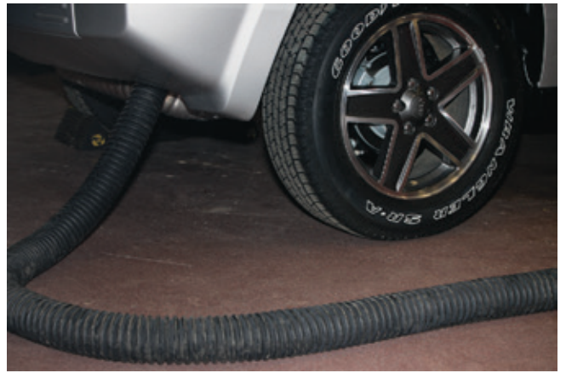
Tool Safety and Equipment (9 of 12)
Venting the Engine’s Exhaust
  Whenever you need to have the engine running for diagnosis or service, the engine’s exhaust must be vented to the outside.
  Carbon monoxide (CO) is present in the exhaust.
    CO is an odorless, tasteless, and colorless deadly gas.
  Most shops have an exhaust ventilation system.

Slide 20
Discussion
You have learned much about how to operate a vehicle in the shop and on a road test.
Have a class discussion while providing several examples of how you can be as safe as possible, and examples of how things could go wrong.

Slide 21
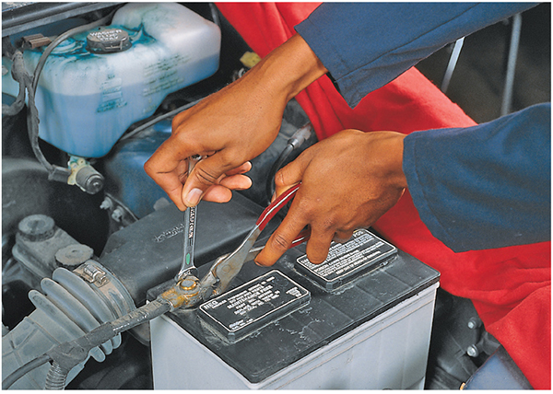
Tool Safety and Equipment (10 of 12)
Electrical Safety
To prevent personal injury or damage to the vehicle, you should always take the necessary precautions before working on or around a vehicle’s electrical system.
Disconnect the negative or ground cable first, then disconnect the positive cable. Because electrical circuits require a ground to be complete, by removing the ground cable you eliminate the possibility of a circuit accidentally becoming completed.

Slide 22
Tool Safety and Equipment (11 of 12)
Battery Precautions
  Here are some of the general precautions for batteries.
    Make sure you are wearing safety glasses (preferably a face shield) and protective clothing when working around and with batteries.
    Keep all flames, sparks, and excessive heat away from the battery at all times, especially when it is being charged.
    Never lay metal tools or other objects on the battery because a short circuit across the terminals can result.
    Always charge a battery in well-ventilated areas.

Slide 23
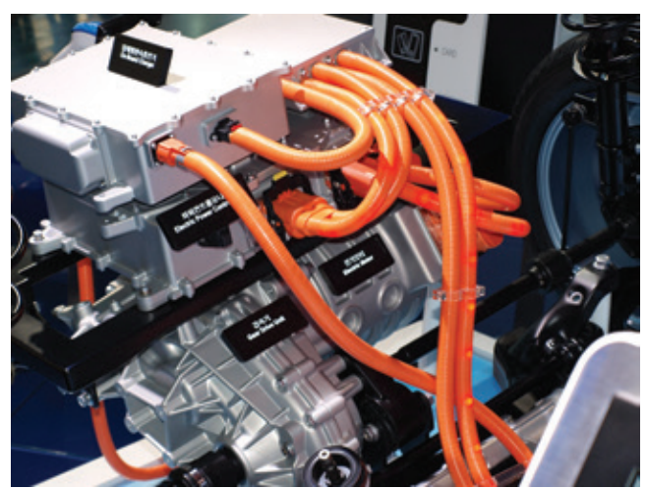
Tool Safety and Equipment (12 of 12)
High-Voltage Systems
Electric drive vehicles (battery-operated, hybrid, and fuel cell electric vehicles) have high-voltage electrical systems (from 42 volts to 800 volts).
These high voltages can kill you! Fortunately, most high-voltage circuits are identifiable by size and color. The cables have thicker insulation and are typically colored orange.

Slide 24
Knowledge Check (1 of 2)
  What color are high-voltage wires and connectors found on hybrid and electric vehicles?

Slide 25
Knowledge Check Answer (1 of 2)
  What color are high-voltage wires and connectors found on hybrid and electric vehicles?
  Answer: Orange

Slide 26
Work Area Safety (1 of 5)
07.04 Understand the importance of safety and accident prevention in an automotive shop.
The floor of your work area and bench tops should be kept clean, dry, and orderly.
Keep all water off the floor. Water is slippery on smooth floors, and electricity flows well through water.
Aisles and walkways should be kept clean and wide enough to easily move through.
Make sure the work areas around machines are large enough to safely operate the machine.
Keep a list of emergency telephone numbers clearly posted.

Slide 27
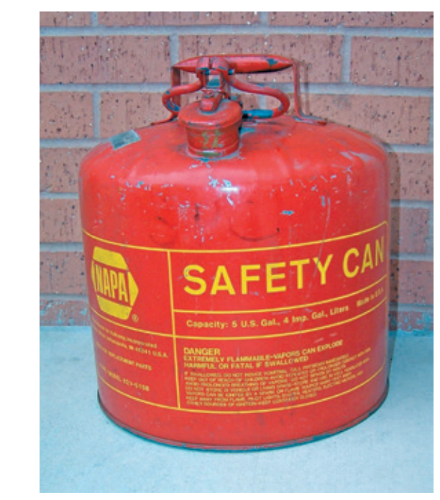
Work Area Safety (2 of 5)
Fire Hazards and Prevention
Something that is flammable catches fire and burns easily.
A volatile liquid is one that vaporizes very quickly.
Flammable volatile liquids are potential fire bombs. Always keep gasoline, ethanol, or diesel fuel in an approved safety can, and never use gasoline to clean your hands or tools.
A slight spark or an increase in heat can cause a fire or explosion.

Slide 28
Work Area Safety (3 of 5)
Ethanol
  Ethanol is a non-petroleum-based fuel and is used as an alternative fuel to gasoline. It is very volatile.
Diesel Fuel
  Diesel fuel is not as volatile as gasoline but should be stored and handled in the same way.
Solvents
  Solvent and other combustible materials are flammable and must be stored in approved and designated storage cabinets or rooms.
Rags
  Oily or greasy rags should be stored in an approved container.

Slide 29
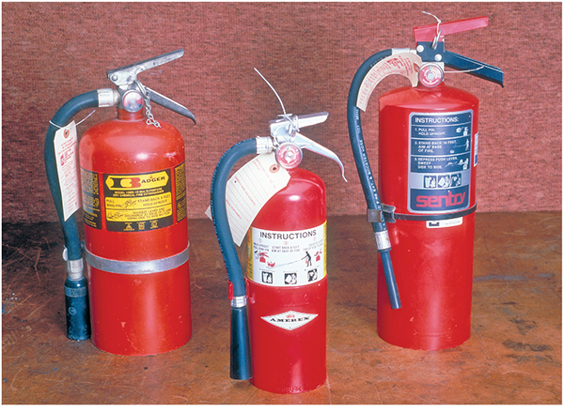
Work Area Safety (4 of 5)
Fire Extinguishers
  Know the location of all fire extinguishers and fire alarms in the shop and how to use them before you need one.
  Be aware of the different types of fires and fire extinguishers.
  All extinguishers are marked with a symbol or letter signifying the class of fire for which they are intended.

Slide 30
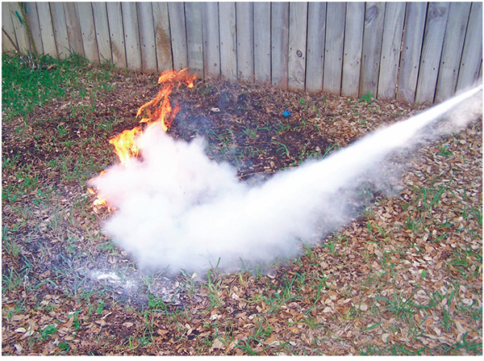
Work Area Safety (5 of 5)
Using a Fire Extinguisher
  To extinguish a fire, stand 6 to 10 feet from the fire.
  Before releasing the agent from the extinguisher, hold the extinguisher firmly in an upright position.
  Aim the nozzle at the base and use a side-to-side motion, sweeping the entire width of the fire.

Slide 31
Manufacturers’ Warnings and Government Regulations (1 of 2)
07.05 Explain manufacturer and government warnings and regulations.
These are the categories of hazards that are found it a typical shop:
  Chemical hazards—caused by high concentrations of vapors, gases, or dust.
  Hazardous wastes—those substances that are the result of a service.
  Physical hazards—include excessive noise, vibration, pressures, and temperatures.
  Ergonomic hazards—conditions that impede normal body position and motion.

Slide 32
Manufacturers’ Warnings and Government Regulations (2 of 2)
OSHA
In 1970, OSHA was formed to “assure safe and healthful working conditions for workers by authorizing enforcement of the standards developed under the Act and by assisting and encouraging the States in their efforts to assure safe and healthful working conditions by providing research, information, education, and training in the field of occupational safety and health.”
The established safety standards are consistent across the country. It is the employer’s responsibility to provide a place of employment free from all recognized hazards. All automotive industry safety and health issues are controlled by OSHA.

Slide 33
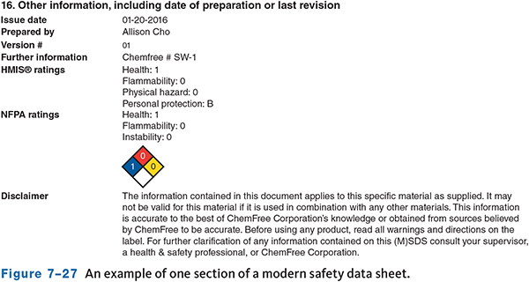
Right-To-Know Law and Right-To-Understand
All employees are protected by Right-To-Know Laws concerning all potentially hazardous materials.
The general intent of Right-To-Know Laws is for employers to provide their employees with a safe working place.
All information about each chemical must be posted on safety data sheets (SDS), which detail the chemical composition and precautionary information for all products that can present a health or safety hazard.

Slide 34
Hazardous Wastes
Many repair and service procedures generate hazardous wastes.
Something is classified as a hazardous waste by the EPA if it is on its list of known harmful materials.
A complete EPA list of hazardous wastes can be found in the Code of Federal Regulations.
A material is only considered a hazardous waste when the shop is ready to dispose of it.
Always keep hazardous waste separate from other wastes.
  Properly label and seal them in the recommended containers.

Slide 35
Guidelines for Handling Shop Wastes (1 of 2)
Some of the common hazardous wastes and what you should do:
Oil
  Recycle oil. Set up equipment, such as a drip table or screen table with a used-oil collection bucket, to collect oil that drips off parts.
Oil Filters
  Drain for at least 24 hours, crush and recycle used oil filters.
Batteries
  Recycle batteries by sending them to a reclaimer or back to the distributor. Store batteries in a watertight, acid-resistant container.

Slide 36
Guidelines for Handling Shop Wastes (2 of 2)
Metal Residue from Machining
  Collect metal filings from machining metal parts and recycle them.
Refrigerants
  Recover and/or recycle refrigerants during the servicing of air-conditioning systems.
Solvents
  Replace hazardous chemicals with less toxic alternatives.
  To reduce the amount of solvent used when cleaning parts, use a two-stage process: dirty solvent followed by fresh solvent.

Slide 37
Knowledge Check (2 of 2)
Describe how to properly use a fire extinguisher.

Slide 38
Knowledge Check Answer (2 of 2)
Describe how to properly use a fire extinguisher.
Answer:
Using a Fire Extinguisher
  To extinguish a fire, stand 6 to 10 feet from the fire.
  Before releasing the agent from the extinguisher, hold the extinguisher firmly in an upright position.
  Aim the nozzle at the base and use a side-to-side motion, sweeping the entire width of the fire.

Slide 39
Chapter Reflection
Please take a moment to compare your perception of the automotive industry before and after you studied this chapter. Then respond to the following questions in one or two paragraphs. Use 150–200 words in your reflection.
Did anything in this chapter catch you by surprise? Anything that you did not realize was unsafe?
Considering all you have learned, do you feel you will be able to work on a day to day basis in a shop environment safely? Anything you feel you can improve upon?

